Slide 2
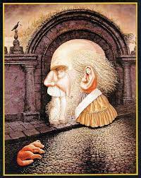
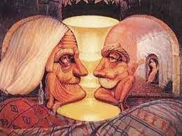
What do the pictures tell you?

Slide 3
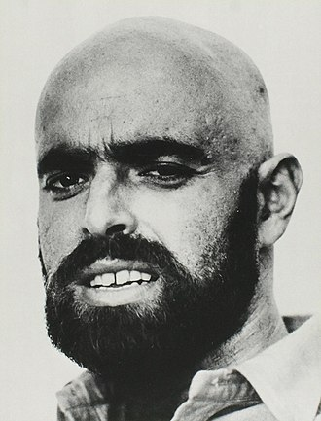
About the poet
Sheldon Allan Silverstein (September 25, 1930 – May 10, 1999) was an American writer, poet, cartoonist, songwriter, and playwright. He was best known for his cartoons, songs, and children's books. He styled himself as Uncle Shelby in some works. His books have been translated into more than 30 languages and have sold more than 20 million copies.

Slide 4
Comprehension
Read the lines ‘I asked…noisy times?’ pg. no. 64
Answer the questions:
Who is the speaker?
b. What question did the speaker ask the zebra?
c. What question did the zebra ask the speaker about habits?
The young boy is the speaker.
The speaker asked the zebra if he was black with white stripes or white with black stripes.
The zebra asked the speaker if he was good with bad habits or bad with good habits.

Slide 5
Vocabulary
Stripes: line or band
Sloppy: careless, messy
Neat: tidy
Quiet: silent
Noisy: lot of noise

Slide 6
Message
The poem states that we are multi-storied. We have different levels and layers to our personality. We can never be one or other of anything. We should look at each other from a different perspective and not judge anyone easily. We should show each other more sympathy.

